Slide 1
Exception Handling in JAVA

Slide 2
Exception in JAVA
The exception handling in java is one of the powerful mechanism to handle the runtime errors so that normal flow of the application can be maintained.

Slide 3
What is Exception ?
Dictionary Meaning: Exception is an abnormal condition.
In java, exception is an event that disrupts the normal flow of the program. It is an object which is thrown at runtime.

Slide 4
What is Exception Handling
What is exception handling
Exception Handling is a mechanism to handle runtime errors such as ClassNotFound, IO, SQL, Remote etc.
Advantage of Exception Handling
The core advantage of exception handling is to maintain the normal flow of the application. Exception normally disrupts the normal flow of the application that is why we use exception handling. Let's take a scenario:
statement 1;
statement 2;
statement 3;
statement 4;
statement 5;//exception occurs
statement 6;
statement 7;
statement 8;
statement 9;
statement 10;
Suppose there is 10 statements in your program and there occurs an exception at statement 5, rest of the code will not be executed i.e. statement 6 to 10 will not run. If we perform exception handling, rest of the statement will be executed. That is why we use exception handling in java.

Slide 5
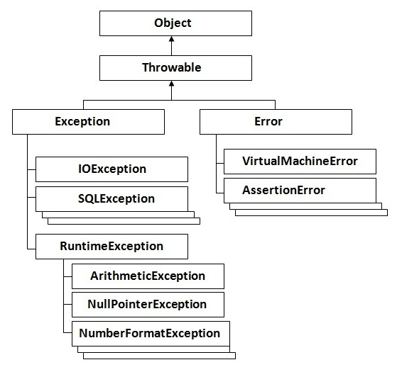
Hierarchy of Java Exception classes

Slide 6
Type of Exception
There are mainly two types of exceptions: checked and unchecked where error is considered as unchecked exception. The sun microsystem says there are three types of exceptions:
Checked Exception
Unchecked Exception
Error

Slide 7
Type of Exception
1) Checked Exception
The classes that extend Throwable class except RuntimeException and Error are known as checked exceptions e.g.IOException, SQLException etc. Checked exceptions are checked at compile-time.
2) Unchecked Exception
The classes that extend RuntimeException are known as unchecked exceptions e.g. ArithmeticException, NullPointerException, ArrayIndexOutOfBoundsException etc. Unchecked exceptions are not checked at compile-time rather they are checked at runtime.
3) Error
Error is irrecoverable e.g. OutOfMemoryError, VirtualMachineError, AssertionError etc.

Slide 8
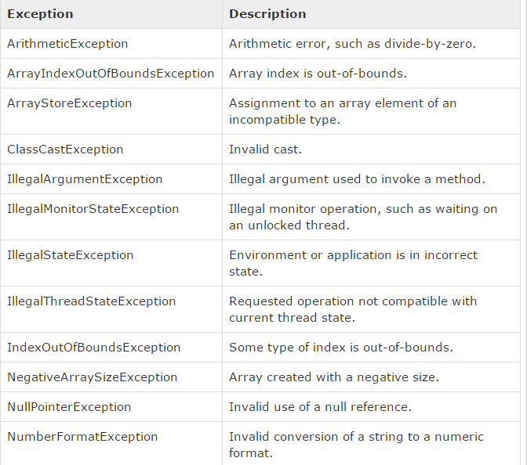
UnChecked Exception

Slide 9
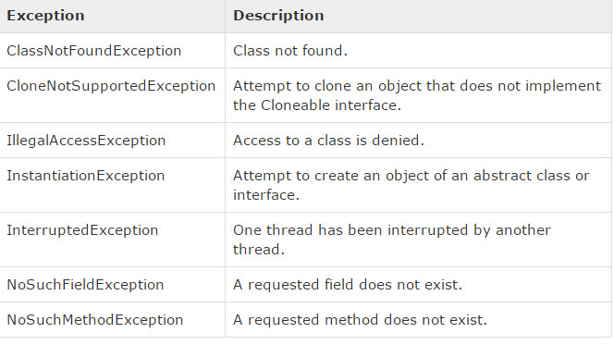
Checked Exception

Slide 10
There are given some scenarios where unchecked exceptions can occur. They are as follows:
1) Scenario where ArithmeticException occurs
If we divide any number by zero, there occurs an ArithmeticException.
int a=50/0;//ArithmeticException
2) Scenario where NullPointerException occurs
If we have null value in any variable, performing any operation by the variable occurs an NullPointerException.
String s=null;
System.out.println(s.length());//NullPointerException
3) Scenario where NumberFormatException occurs
The wrong formatting of any value, may occur NumberFormatException. Suppose I have a string variable that have characters, converting this variable into digit will occur NumberFormatException.
String s="abc";
int i=Integer.parseInt(s);//NumberFormatException
4) Scenario where ArrayIndexOutOfBoundsException occurs
If you are inserting any value in the wrong index, it would result ArrayIndexOutOfBoundsException as shown below:
int a[]=new int[5];
a[10]=50; //ArrayIndexOutOfBoundsException

Slide 11
Java Exception Handling Keywords
There are 5 keywords used in java exception handling.
try
catch
finally
throw
throws

Slide 12
JAVA try-catch
Java try block is used to enclose the code that might throw an exception. It must be used within the method.
Java try block must be followed by either catch or finally block.
Syntax of java try-catch
try{
//code that may throw exception
}catch(Exception_class_Name ref){}
Syntax of try-finally block
try{
//code that may throw exception
}finally{}

Slide 13
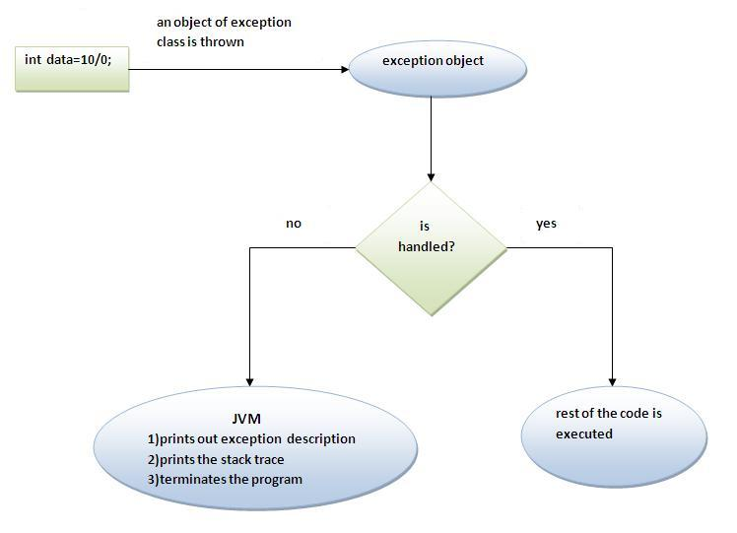
Internal working of java try-catch block

Slide 14
The JVM firstly checks whether the exception is handled or not. If exception is not handled, JVM provides a default exception handler that performs the following tasks:
Prints out exception description.
Prints the stack trace (Hierarchy of methods where the exception occurred).
Causes the program to terminate.
But if exception is handled by the application programmer, normal flow of the application is maintained i.e. rest of the code is executed.

Slide 15
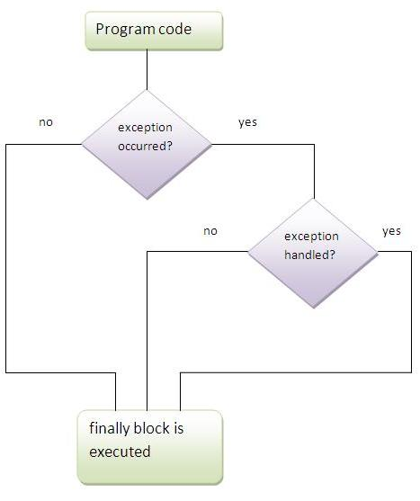
Java Finally Block

Slide 16
Java Finally Block
Java finally block is a block that is used to execute important code such as closing connection, stream etc.
Java finally block is always executed whether exception is handled or not.
Java finally block must be followed by try or catch block.

Slide 17
Java throw exception
Java throw keyword
The Java throw keyword is used to explicitly throw an exception.
We can throw either checked or uncheked exception in java by throw keyword. The throw keyword is mainly used to throw custom exception.
The syntax of java throw keyword is given below.
throw exception;
Let's see the example of throw IOException.
throw new IOException("sorry device error);

Slide 18
Java Throw Example….
public class TestThrow1{
static void validate(int age){
if(age<18)
throw new ArithmeticException("not valid");
else
System.out.println("welcome to vote");
}
public static void main(String args[]){
validate(13);
System.out.println("rest of the code...");
}
}

Slide 19
Java throws keyword
The Java throws keyword is used to declare an exception. It gives an information to the programmer that there may occur an exception so it is better for the programmer to provide the exception handling code so that normal flow can be maintained.
Exception Handling is mainly used to handle the checked exceptions. If there occurs any unchecked exception such as NullPointerException, it is programmers fault that he is not performing check up before the code being used.
Syntax of java throws
return_type method_name() throws exception_class_name{
//method code
}

Slide 20
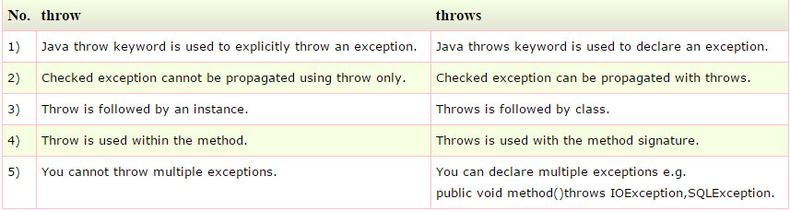
Difference between Throw & Throws

Slide 21
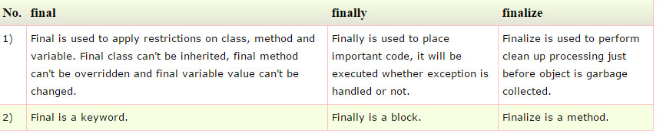
Difference Between Final , Finally & Finalize

Slide 22
Final Example
class FinalExample{
public static void main(String[] args){
final int x=100;
x=200;//Compile Time Error
}
}

Slide 23
Finally Example
class FinallyExample{
public static void main(String[] args){
try{
int x=300;
}catch(Exception e){System.out.println(e);}
finally{System.out.println("finally block is executed");}
}}

Slide 24
Finalize Example
class FinalizeExample{
public void finalize(){
System.out.println("finalize called");}
public static void main(String[] args){
FinalizeExample f1=new FinalizeExample();
FinalizeExample f2=new FinalizeExample();
f1=null;
f2=null;
System.gc();
}
}

